Slide 1
Linear Regression
Gradient Descent

Slide 2
What is Regression?
Supervised learning algorithm.
Consists of one or more feature values and a corresponding single output value.
Output is a continuous value.
Learns the line, plane or hyperplane that best fits the training samples.

Slide 3
Linear Regression
Linear Model: assumes linear relationship between input variables (x) and a single output variable (y).
Simple Linear Regression: single input variable (x).
Multiple Linear Regression: multiple input variables (x₁, x₂,…,x_{n}).

Slide 4
Linear Regression
Given an input x we would like to compute an output y
For example:
- Predict height from age
- Predict Google’s price from Yahoo’s price
- Predict distance from wall from sensors
y
x

Slide 5
Linear Regression
In linear regression we assume that y and x are related with the following equation:
y = b0+b1.x+ε
where ‘b0’ is a intercept at y-axis, ‘b1’ is slope of line, ‘ε’ represents error in measurement or other noise
What we are trying to predict
Feature values
y
x

Slide 6
Linear Regression
Goal: to estimate w from a training data of <x_{i}, y_{i}> pairs
Optimization goal: minimize squared error (least squares)
y = b0+b1.x
y
b1
Predicted( y)
Actual( y)
Error Term (e)
b0
x
Notes:
Why least squares?
- minimizes squared distance between measurements and predicted line

Slide 7
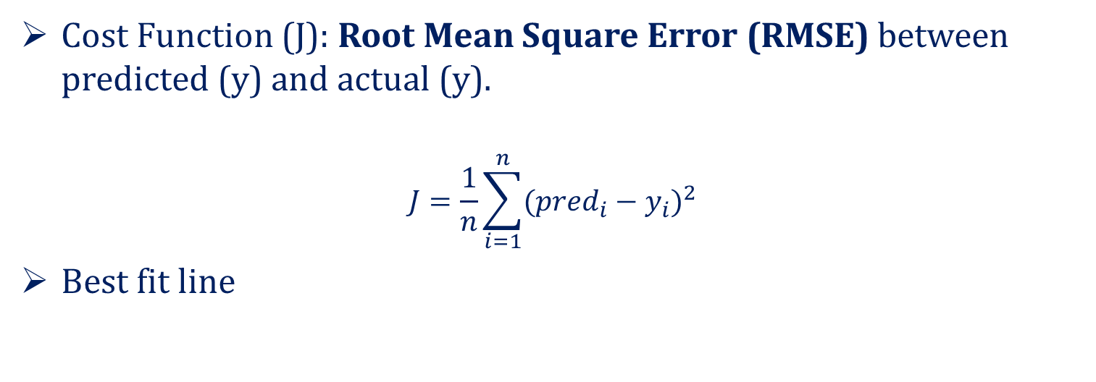
Cost Function
Cost Function (J): Root Mean Square Error (RMSE) between predicted (y) and actual (y).
$$J=\frac{1}{n}\sum_{i=1}^{n}{{({pred}_{i}−y_{i})}^{2}}$$
Best fit line

Slide 8
Gradient Descent
Method of updating b0 and b1 values, to reduce the RMSE.
Gradient Descent Algorithm:
Start with initial guess of coefficients.
Keep changing the coefficients little bit to try and reduce the cost function J(b0,b1).
Each time the parameters are changed the gradient is chosen which reduces J(b0,b1) the most.
Repeat
Keep doing till no improvement is made.

Slide 9
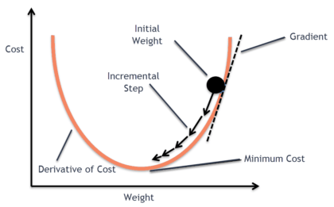
Gradient Descent

Slide 10
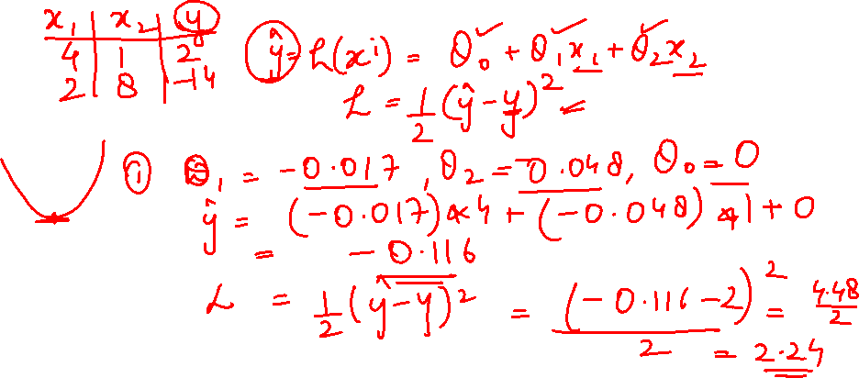
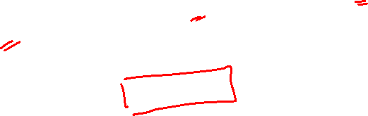
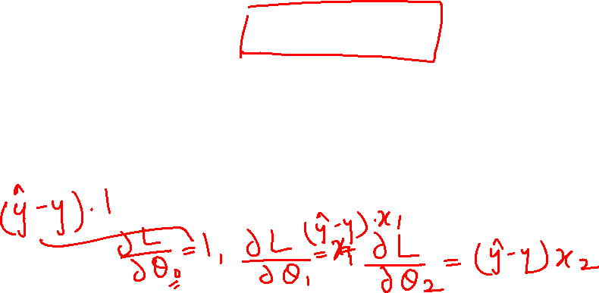
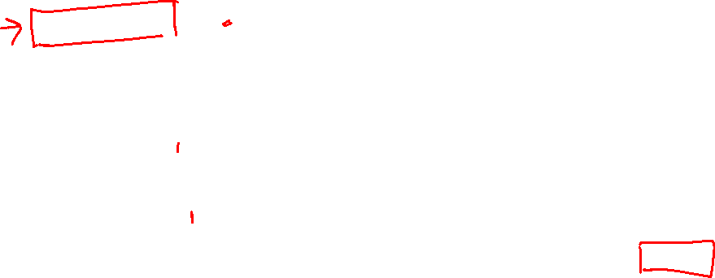

Slide 11
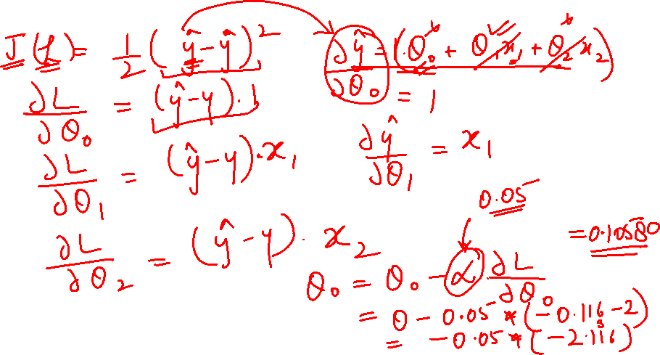


Slide 12
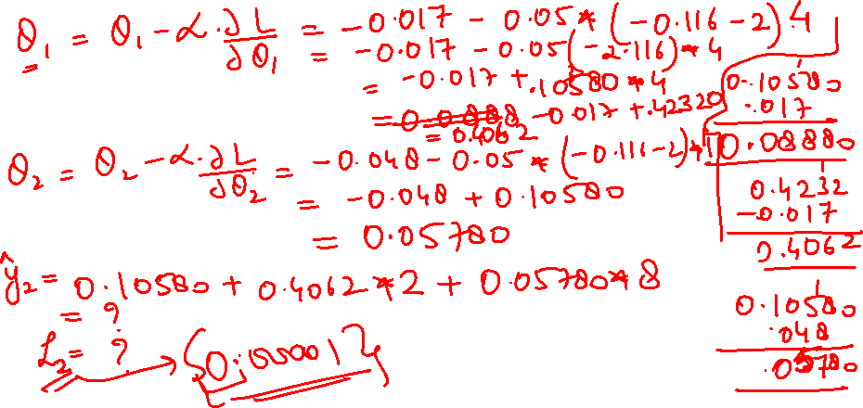

Slide 13
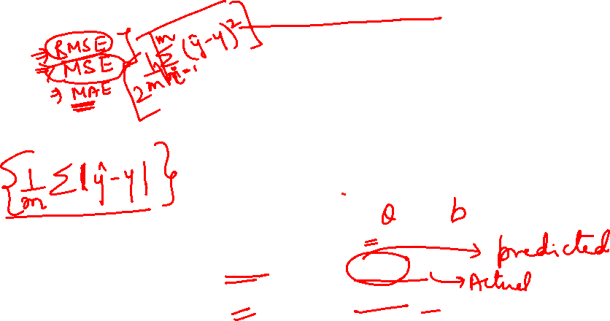
Regression loss functions
4
3
2
1
0
-3 -2 -1 0 1 2 3
residual (w · φ(x)) − y
Loss_{squared}(x, y, w) = (w · φ(x) − y)²
Loss_{absdev}(x, y, w) = |w · φ(x) − y|
Loss(x, y, w)
40

Slide 14
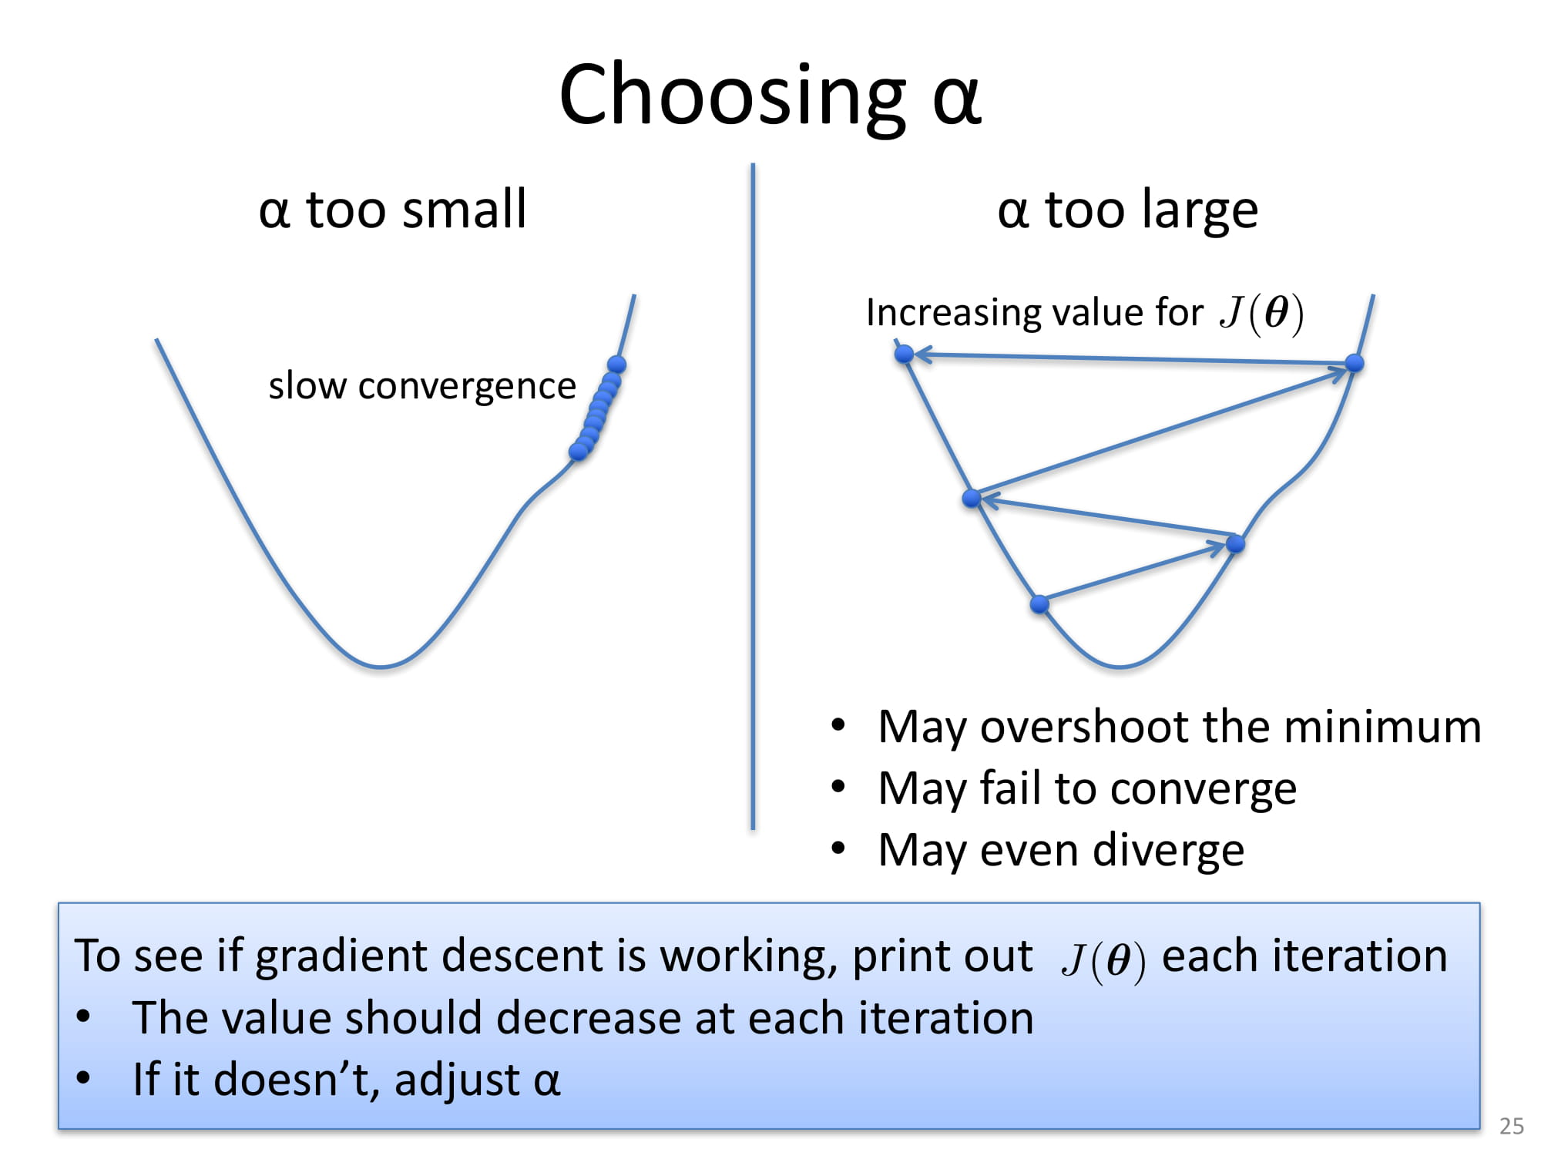
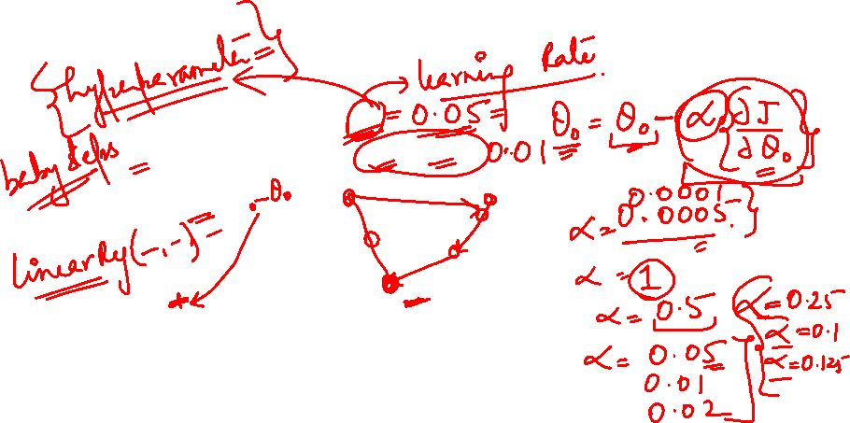

Slide 15
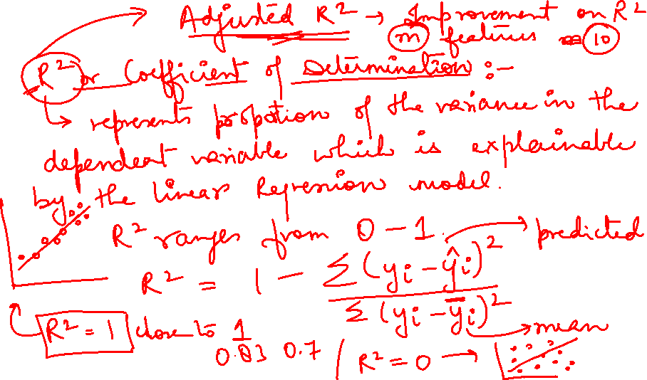
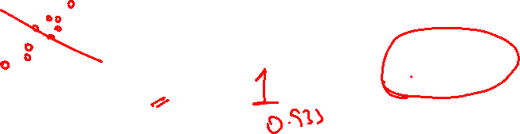

Slide 16
Demo
https://www.geogebra.org/m/FUe3HfRf

Slide 17
Polynomial Regression

Slide 18
Goal of this Session:
Understand how to extend simple OLS linear regression in a flexible way using polynomial regression.

Slide 19
Moving Beyond Linearity:
The linearity assumption is good in many machine learning problems.
However, there are other methods that offer a lot of flexibility, without losing the ease and interpretability of linear models
Polynomial regression

Slide 20
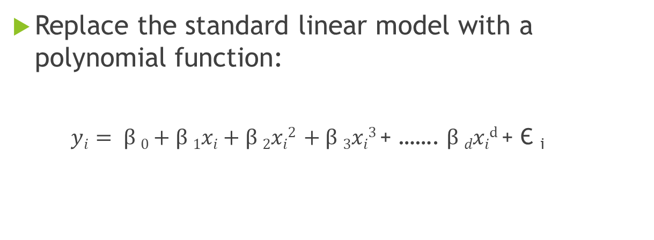
Polynomial Regression:
Replace the standard linear model with a polynomial function:
$yi= β 0+β 1xi+β 2xi2 +β 3xi3$ + ……. $β dxid$ + Є _{i}

Slide 21
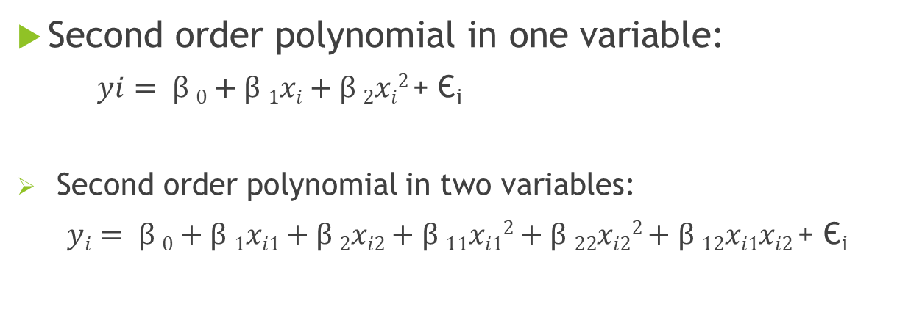
Polynomial Regression:
Second order polynomial in one variable:
$yi= β 0+β 1xi+β 2xi2$+ Є_{i}
Second order polynomial in two variables:
$yi= β 0+β 1xi1+β 2xi2+β 11xi12$ $+ β 22xi22$ $+ β 12xi1xi2$ + Є_{i}

Slide 22
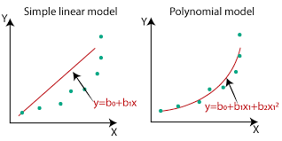
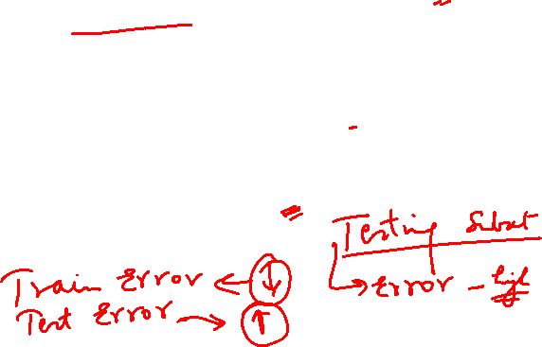
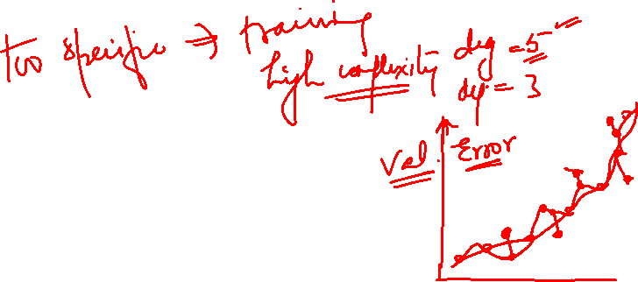

Slide 23
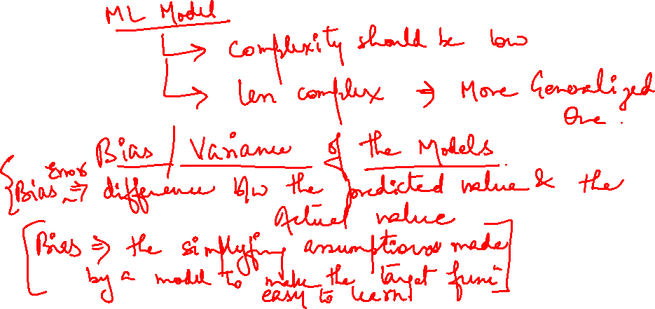


Slide 24
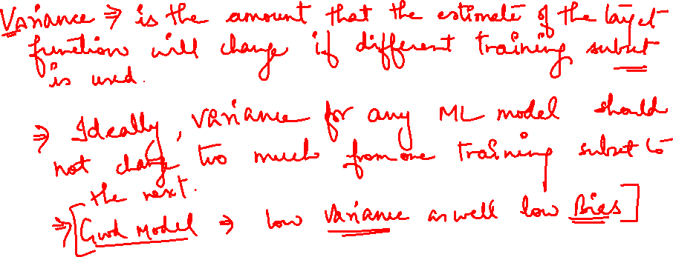

Slide 25
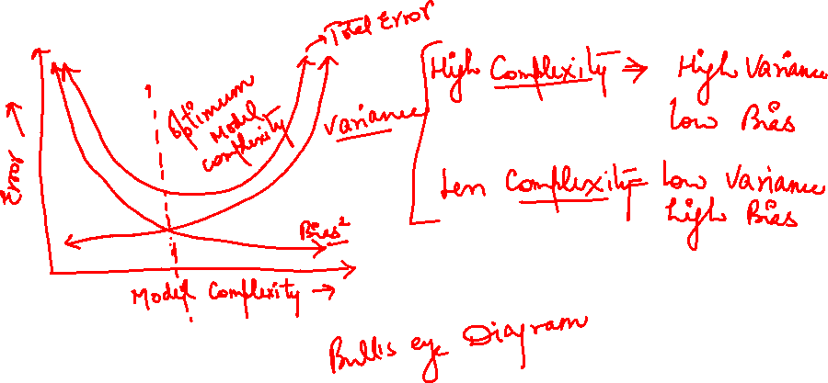
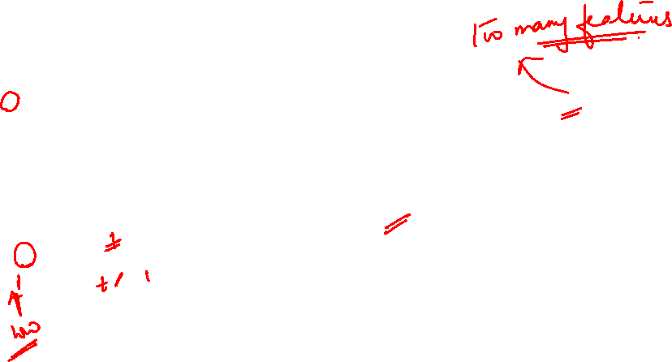

Slide 26
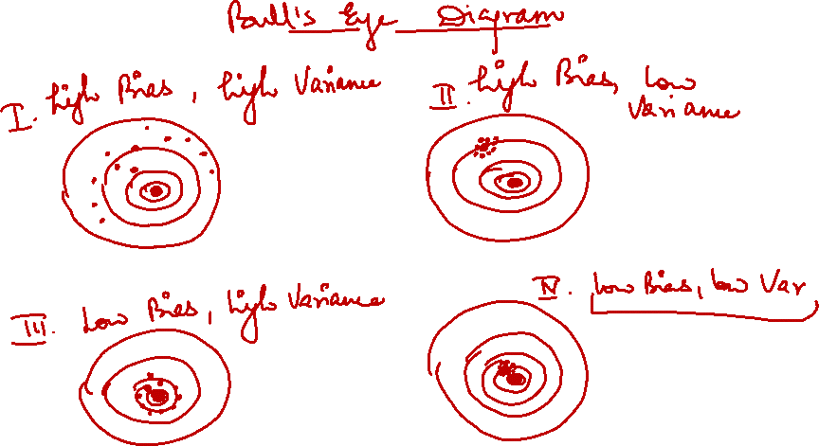
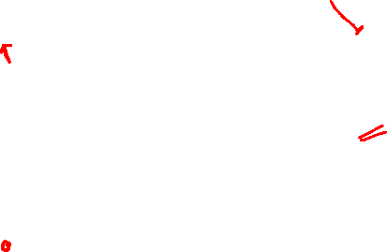

Slide 27
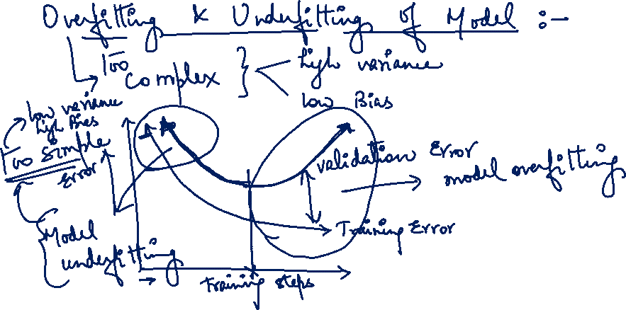

Slide 28
Order of the Polynomial Model:
The order (k) should be as low as possible.
The high-order polynomials (k > 2) should be avoided unless they can be justified for reasons outside the data.
Complex models can result in “model overfitting”

Slide 29
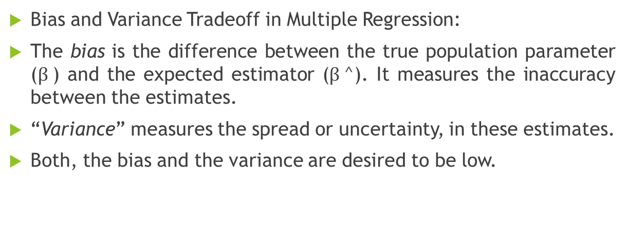
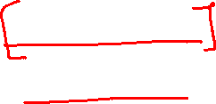
Regularization in Regression Models:
Bias and Variance Tradeoff in Multiple Regression:
The bias is the difference between the true population parameter ($β$) and the expected estimator ($β$^). It measures the inaccuracy between the estimates.
“Variance” measures the spread or uncertainty, in these estimates.
Both, the bias and the variance are desired to be low.

Slide 30
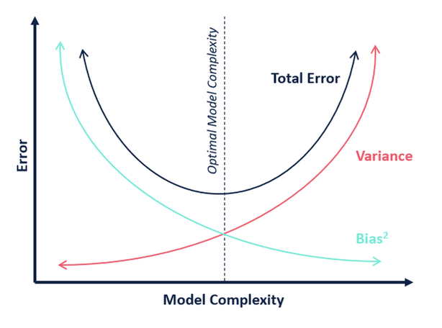

Slide 31
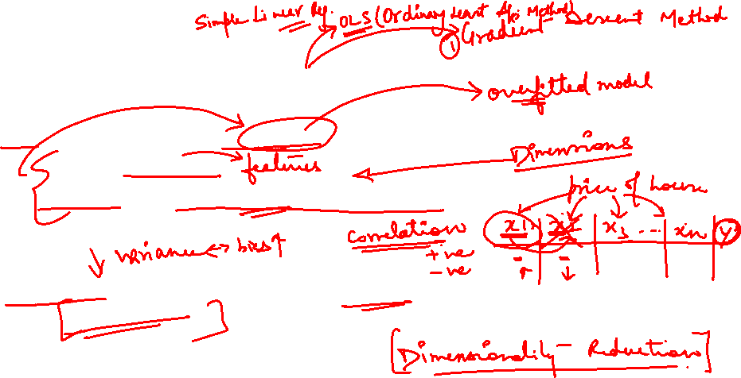
Regularization in Regression Models:
OLS estimator can have huge variance that results due to:
too many predictors
Predictors are highly correlated with each other.
Solution:
Reduce variance at the cost of introducing some bias. This approach is called “Regularization”

Slide 32
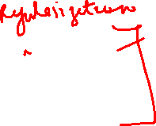
Regularization in Regression Models:
Ridge Regression
Lasso Regression
Elastic Net

Slide 33
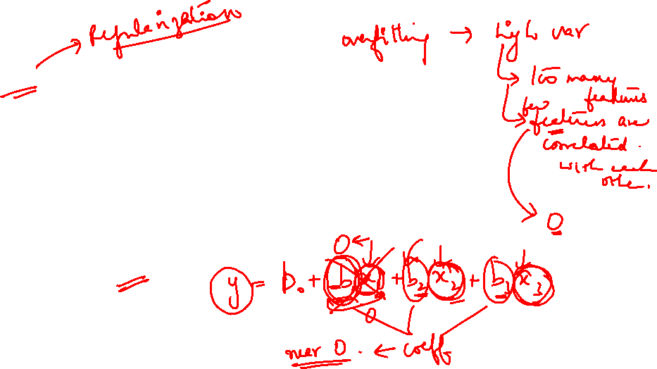
Ridge Regression
Instead of forcing the predictors to be zero (i.e. removing them from the model), ridge regression penalize them if they are too far from zero.
Thus, forcing the predictors to be small in a continuous way.
This way, it decreases model complexity while keeping all variables in the model.
Also, called as L2-penalty.

Slide 34
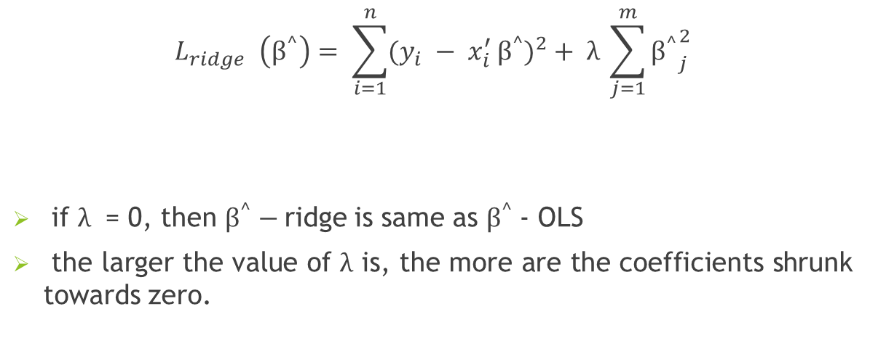
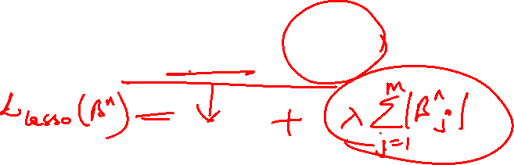
Ridge Regression
$$L_{ridge }\left(β^{^}\right)= \sum_{i=1}^{n}{{(y_{i} − x_{i}^{′ }β^{^})}^{2}}+ λ \sum_{j=1}^{m}{{β^{^}}_{j}^{2}}$$
if $λ$ = 0, then $β^{^}−$ridge is same as $β^{^}$- OLS
the larger the value of $λ$ is, the more are the coefficients shrunk towards zero.

Slide 35
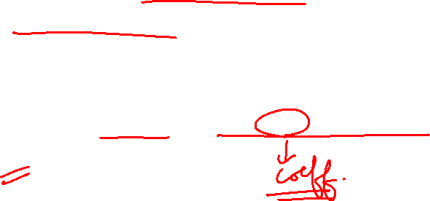
Lasso Regression (Least Absolute Shrinkage and Selection Operator)
Similar to ridge
Unlike ridge regression which penalizes sum of squared coefficients, it penalizes the sum of their absolute values.
L1 penalty

Slide 36
Elastic Net
Combines ridge and lasso

